Slide 1

IBM Advanced Data Science Capstone Project System of mood classification
Ricardo Santos

Slide 2
Agenda:
Use case
Data source
Exploratory Data Analysis (EDA): sentiments & tweets text
ETL overview
Sentiment Analysis Modelling: specification, training & evaluation
Deployment and benchmarking
Final Comments and Future Developments

Slide 3





Use case:
Every day millions of people share their opinions on social media. The content can vary from product reviews to points of view, analysis, or plain comments about politics, healthcare, financial markets conditions, climate change, and other subjects. This opens a vast opportunity to use information technologies to mine, track down, and understand these sentiments.
Social media statistics*:
500 million tweets are sent per day.
500 million people use Instagram Stories every day.
7 million businesses use Facebook for advertising.
More than 30 million companies are listed on LinkedIn.
Given the high volume of such knowledge, it is humanly impossible to analyze the content of each thought.
Here is where Sentiment Analysis adds its value.
Sentiment Analysis is the process of computationally identifying and categorizing (e.g. negative, positive) such opinions expressed in a piece of text.
The present project proposes a system of mood classification prototype learned from sentiments on Twitter’s posts.
* source: http://socialpilot.co/blog/social-media-statistics.

Slide 4
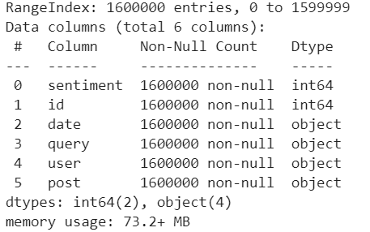
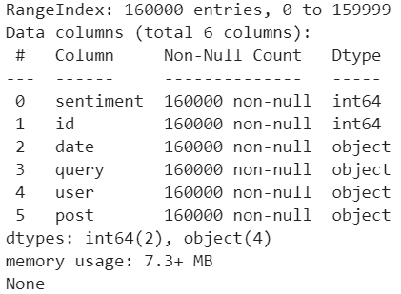
Data source:
The system of mood classification here proposed was developed using the Sentiment140 dataset.
The dataset Sentiment140 contains 1.600.000 tweets, extracted using the Twitter API, where the tweets have been computationally tagged as:
0 = negative sentiment
2 = neutral sentiment*
4 = positive sentiment
The Sentiment140 contains 6 features, recorded respectively in the order:
the polarity of the tweet (0, 2 or 4), here named as sentiment
the id of the tweet (e.g. 2087), here named as id
the date of the tweet (e.g. Sat May 16 23:58:44 UTC 2009), here named as date
the query (lyx), here named as query.
the user that tweeted (e.g. robotickilldozr), here named as user
the text, content of the tweet (e.g. Lyx is cool), here named as post
In order to gain time efficiency, a random sample (10%) was extracted from the 1.6MM
datapoints sets.
The dataset was read into memory from a 228MB csv file.
DATASET
SAMPLE
working sample with 160.000 tweets and sentiments
*though none was founded in the training dataset

Slide 5
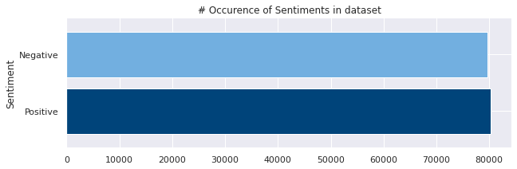
Exploratory Data Analysis (EDA): tweets sentiment overview
Positive-sentiment tweets were firstly re-tagged, in order to feed the model with an input label in the domain 0 (negative) or 1 (positive):
From the random sample extracted, a balanced distribution of both positive and negative sentiment tweets was found.
The dataset sample contains the following sentiment distribution:
80.262 Positive
79.738 Negative

Slide 6
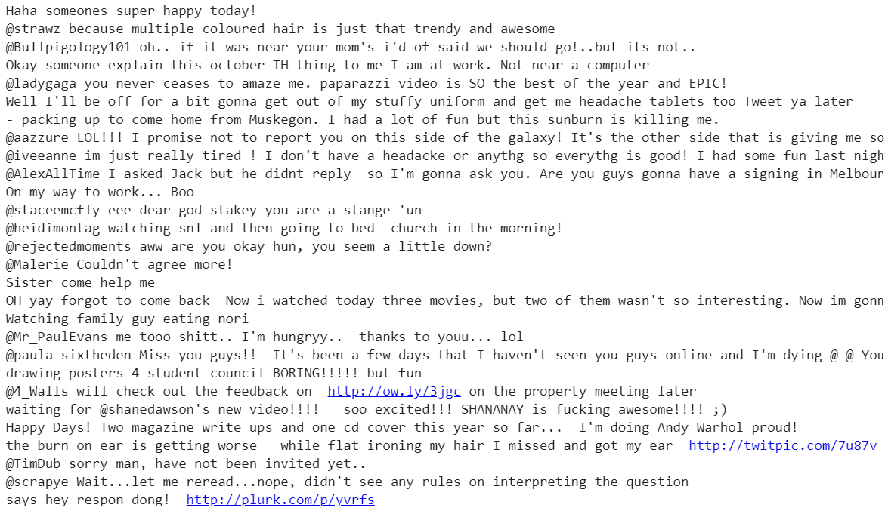
Exploratory Data Analysis (EDA): tweets text overview
Tweets text sample:
Twitter posts can be quite irregular.
They are more informal and freely-written, which means words do not need to be grammatically correct or to follow any language convention.
This poses a challenge for Sentiment Analysis when the computer learns from noisy social media sources.
Irregularities found in posts:
abbreviations: y, u, y r, anythg, everythg
(un)intentionally spelling errors: underxposed, unfortunetly
intensity: byeeeeeeeee, youuuuu, morniiiiiinnnnggg

Slide 7
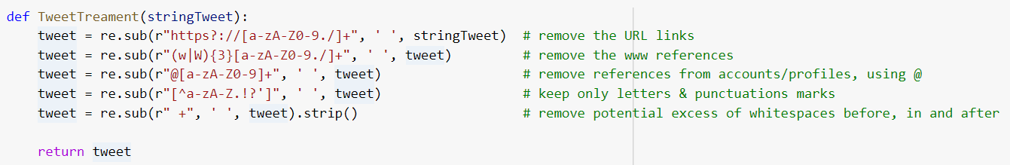
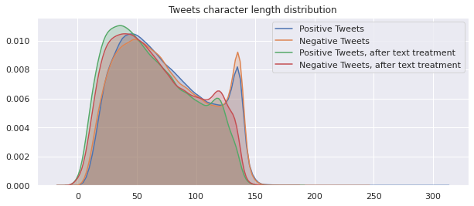
Exploratory Data Analysis (EDA): tweets text overview
Tweets texts were treated to remove all sort of noise and non-essencial information for the analysis:
applied cleansing filters
After text treatment, there was no significant change in Tweets distributions, indicating that little information was lost in the cleansing process.
Tweets median length in characters (ch.) terms are between:
58 - 62 ch., before treatment
69 - 70 ch., after treatment

Slide 8
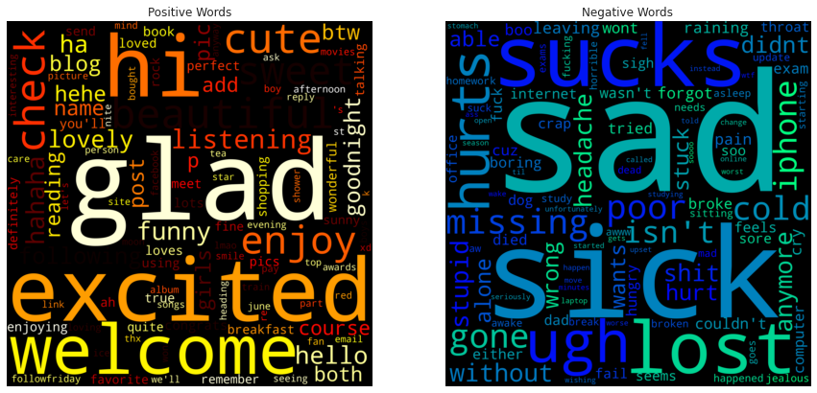
Exploratory Data Analysis (EDA): tweets text overview
The 100 most frequent words found in positive or negative sentiment tweets*:
It is possible to notice a correlation between the meaning of the word and the sentiment associate with it.
Words expressing positive emotions, e.g. glad, enjoy, welcome, loves, funny, perfect, etc. were found mostly in positive-sentiment tweets.
Words expressing negative emotions, e.g. sick, sucks, hurts, lost, wrong, broke, etc. were found mostly in negative-sentiment tweets.
Positive Words
Negative Words
*For visualization, it was focused only on the most frequent words found in a sentiment group, that was not founded in the other sentiment group.

Slide 9
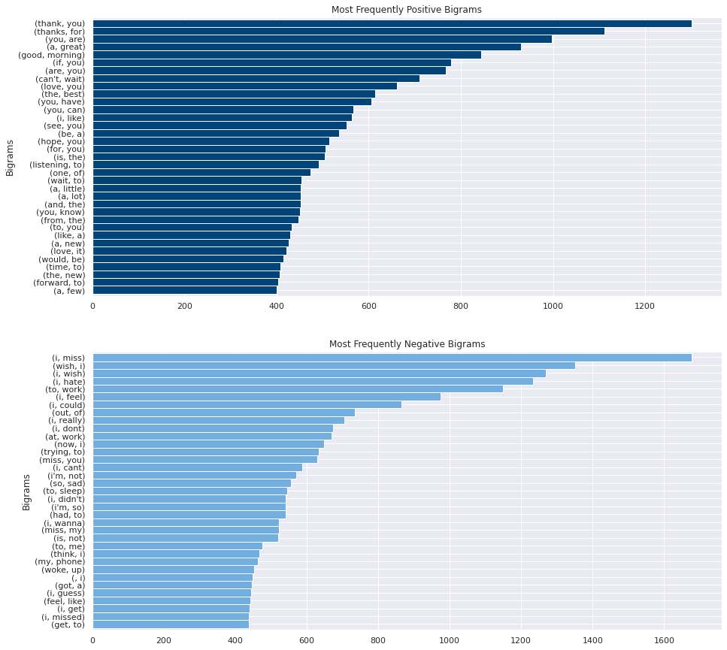
Exploratory Data Analysis (EDA): tweets text overview
The 35 most frequent bigrams found in positive and negative sentiment tweets*
Bi-grams, or n-grams of size 2, are just a sequence of words. Whenever in a sentence, twos words are next to each other, they form a bi-gram.
*For visualization purpose, it was focused only on the most frequent bigrams found in a sentiment group, that was not founded in the other sentiment group.

Slide 10
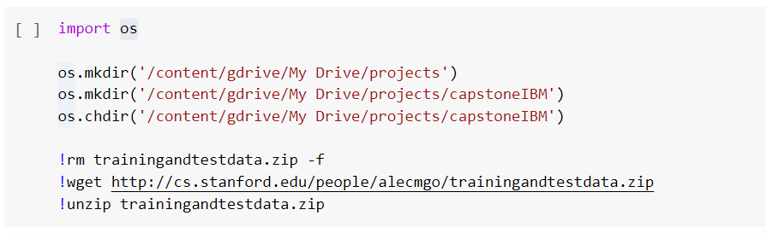
ETL overview
Extraction: data was extracted to a file storage service (e.g. Google Drive), but it could be extracted to an object storage (Google Cloud, AWS, etc.) as well.
training.1600000.processed.noemoticon.csv
228 MB
data source
testdata.manual.2009.06.14.csv
72 KB
Transformations: the set of transformations executed are formed by:
sentiment (re)tagging: to ensure that inputs labels will be in the domain 0 or 1, see slide
tweets text treatment: data cleansing, removing noisy words, and non-essential information, see slide
tokenization: converting each word in a tweet to a unique number (integer), called tokens, see next slide
padding: process of normalizing the length for each tokenized tweet, see next slide
Loading: as best practice, dataset was splitted in training set (80%) and testing set (20%) before loading into the model.

Slide 11
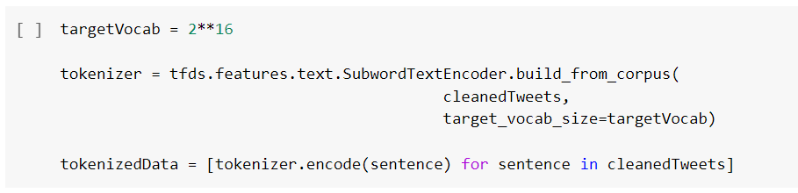
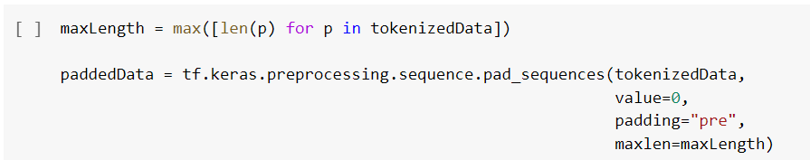
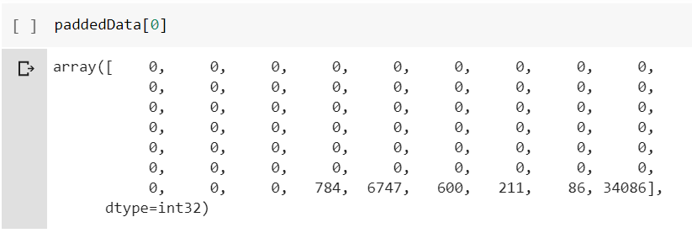
ETL overview
tokenization: is the process of converting each word in a text (tweet) to a unique number (integer), called token. This is a common task in NLP, since computers learn words from numbers, not characters.
To execute this transformation, the following TensorFlow’s methods were used:
.text.SubwordTextEncoder.build_from_corpus()
.encode()
Point of decision: the vocabulary size (targetVocab) is a critical variable, as a large vocabulary size will result in a high number of word embedding parameters in the model, and therefore large storage or memory. Searching in Google, we see that an average Englisch speaker knows around 20.000-40.000 words. For our experiment, we will use the targetVocab = 2**16, or the most 65.536 important words.
padding: some tweets have more words than others, and this is where the padding is necessary. Padding represents the process of normalizing the length for each tokenized tweet by completing it with 0.
input data used to train the model.
Keras’s .sequence.pad_sequences() was used for padding. For common length (maxLength), the maximum length of the tokenized data found in the random sample was used.

Slide 12
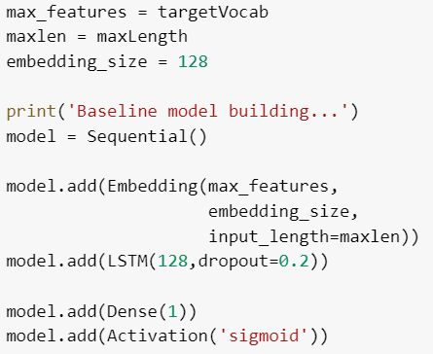
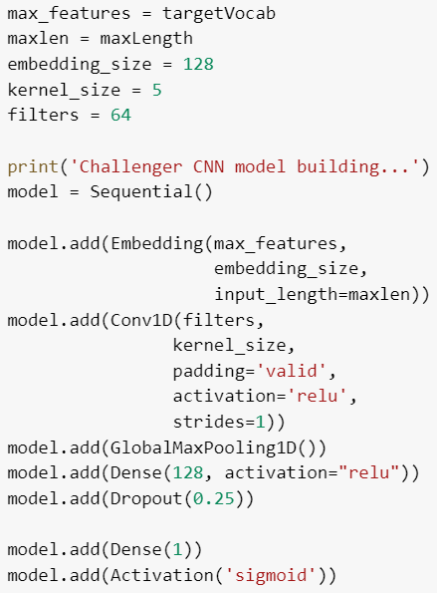
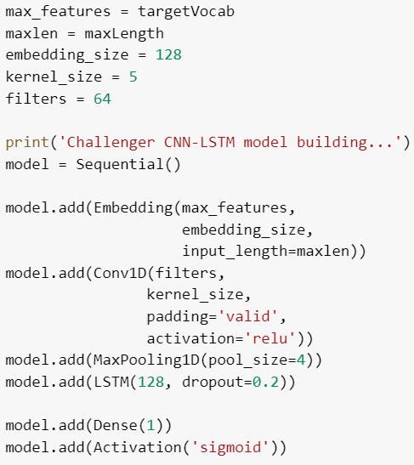
Sentiment Analysis Modelling: specification, training and evaluation
As a baseline model, the Long Short-Term Memory networks (LSTM) was chosen. The LSTM are a special type of Recurrent Neural Networks (RNN). RNNs models for text classification take in consideration not only individual words, but also the order they appear in*.
To challenge the baseline model, a Convolutional Neural Network (CNN) and a hybrid LSTM-CNN model was chosen. CNNs are a class of deep, feed-forward neural networks, and use a variation of multilayer perceptrons designed to require minimal preprocessing.
Baseline Model
CNN Model
CNN-LSTM Model
CNNs** models are trained to recognize patterns across space, while the CNN-LSTM are a class of models that learn patterns both in space and time.
For binary classification, the sigmoid activation function was chosen for the 3 models.
Therefore, the whole NN must be projected into a single unit output layer (Dense(1)).
* e.g. “I won’t say that I like it” has the words “like it”; a system that does not consider the “won’t” before might classify the sentence as positive.
** CNNs are best known for their breakthrough in Image Classification, though they also have performed well in NLP classification tasks such as Sentiment Analysis, Span Detection, Auto tagging of customer queries, and Topic Categorization.

Slide 13
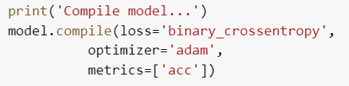

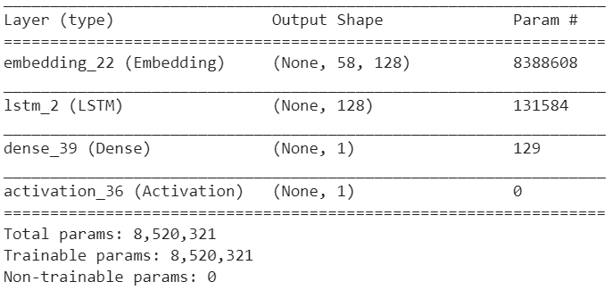
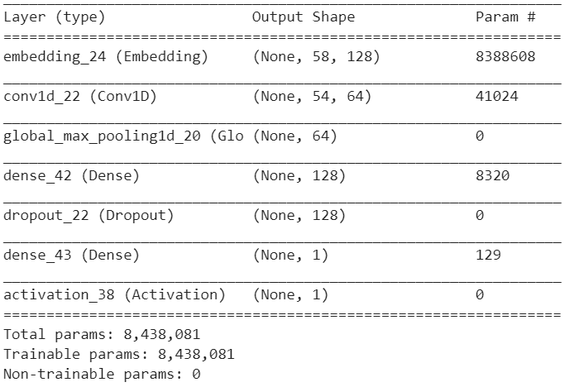
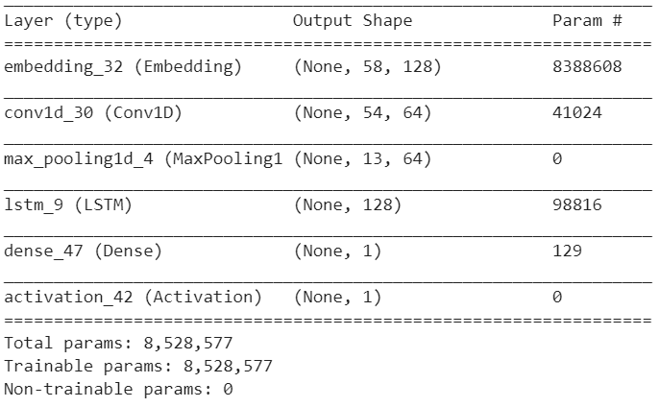
Sentiment Analysis Modelling: specification, training and evaluation
further common specifications:
As for the Loss function that the model seeks to minimize during training, the BinaryCrossentropy class was used for the 3 models. It computes the cross-entropy loss between true labels and predicted labels.
As for the Optimizer’s algorithm, the Adam class was also used for the 3 models.
The batch size was set to 32 and 10 epochs were used for each model.
model's summary:
Baseline Model
CNN Model
CNN-LSTM Model
The 3 models presented a relatively high number of parameters since its number of maximum features has the same size as the vocabulary size, see slide.

Slide 14
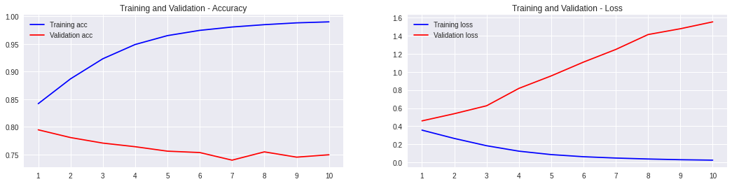
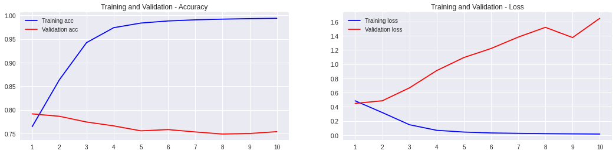
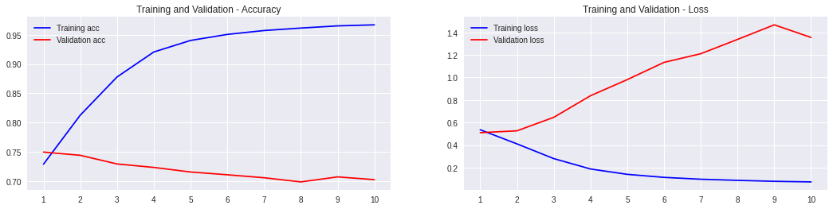
Sentiment Analysis Modelling: specification, training and evaluation
Training and Testing results: accuracy and loss results in training and testing set
Accuracy
Loss
The models results shows that:
each model reaches a relatively high accuracy in the training set after just 2-4 epochs.
at a second moment, the models learn in the training set (accuracy gets higher) at cost of a higher loss in the testing set
The models’ results are satisfactory (~75-80%), although item (b) show a typical behavior of over-fitting.
Below the models’ results at the best epoch:
Overall, the results are very similar, but the CNN model excels for its processing time.
Baseline
CNN
Best result:
Loss:
Accuracy:
Time p. epoch*:
Baseline
1st ep.
0.46
79.4%
733s
CNN
1st ep.
0.45
79.1%
60s
CNN-LSTM
1st ep.
0.51
75%
240s
CNN-LSTM
* Using the NVIDIA Tesla K80 GPU provided by Google

Slide 15
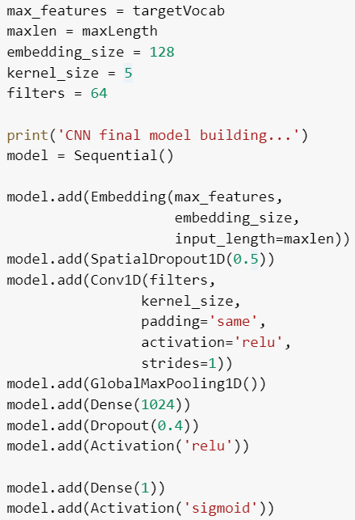
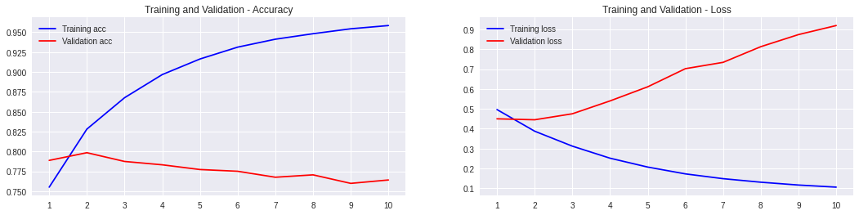
Sentiment Analysis Modelling: revisiting the CNN model
In other to increase its performance, the CNN model was revisited:
final model's summary:
As a final exercise, to check if additional datapoints could further increase the model’s accuracy, the whole process was re-executed considering the whole 1.6MM tweets dataset:
For the final model, was added:
a SpatialDropout1D(0.5) layer
a Dense(1024) plain vanilla layer
a Dropout(0.4) layer (in place the 0.25 from the older version)
The results show an increase in the accuracy in the testing set (79.85%), in the 2nd epoch. After that, the model starts only to memorize the training set.
The time to process has also outperformed the other models: 60s per epoch.
* Using the NVIDIA Tesla K80 GPU provided by Google
{trans-formation}
{trans-formation}
{trans-formation}
{trans-formation}
training set (80%)
Final
CNN model
Final CNN model has shown no increase or loss of significant accuracy (~76.5%) in the testing set.
Process Overview
testing set (20%)
Full Dataset
retagging
text cleansing
tokenization
padding
data splitting
model training

Slide 16
Deployment and bechmarking
As an application and, also to benchmark, the proposed system was compared with an on-market sentiment analysis tool.
The NLTK’s VADER (Valence Aware Dictionary and sEntiment Reasoner)* was used for benchmarking: for a sample of sentences, it was tested how both systems classify its sentiment.
Sentence
Prototype
NLTK‘s VADER
That is not right
He is a nice guy
I like her voice
That is fair
Data Science is awesome
That was a big waste of my time
I cannot say that I liked this movie
He just does not care
She is getting on my nerves
His behavior is not acceptable
Deep Learning is cool
Big Tech will save the financial markets
She is trustful
Big Tech will cause the next market crash
He is cheating on me
He’s absolutely terrified of them
Negative
Positive
Positive
Positive
Positive
Negative
Negative
Negative
Negative
Negative
Positive
Positive
Positive
Negative
Negative
Negative
Neutral (0.00)
Positive (0.42)
Positive (0.36)
Positive (0.31)
Positive (0.62)
Negative (-0.42)
Negative (-0.32)
Negative (-0.38)
Negative (-0.10)
Negative (-0.24)
Positive (0.31)
Positive (0.49)
Positive (0.47)
Negative (-0.40)
Negative (-0.55)
Negative (-0.64)
For the proposed system of mood classification, the decision rule was:
if the system predicted value is above 0.5, the sentiment is Positive otherwise, it is Negative.
For the NLTK’s VADER, the decision rule is slightly more complex, as it is a multi-class classification system.
VADERS algorithm outputs sentiment scores to 4 classes of sentiments: negative, neutral, positive, and compound.
For VADER, the decision rule was:
if the system compound predicted value is above 0, the sentiment is Positive otherwise, it is Negative.
The proximity of sentiment between both systems is quite close.
* VADER is a lexicon and rule-based sentiment analysis tool that is specifically attuned to sentiments expressed in social media (https://github.com/cjhutto/vaderSentiment)

Slide 17
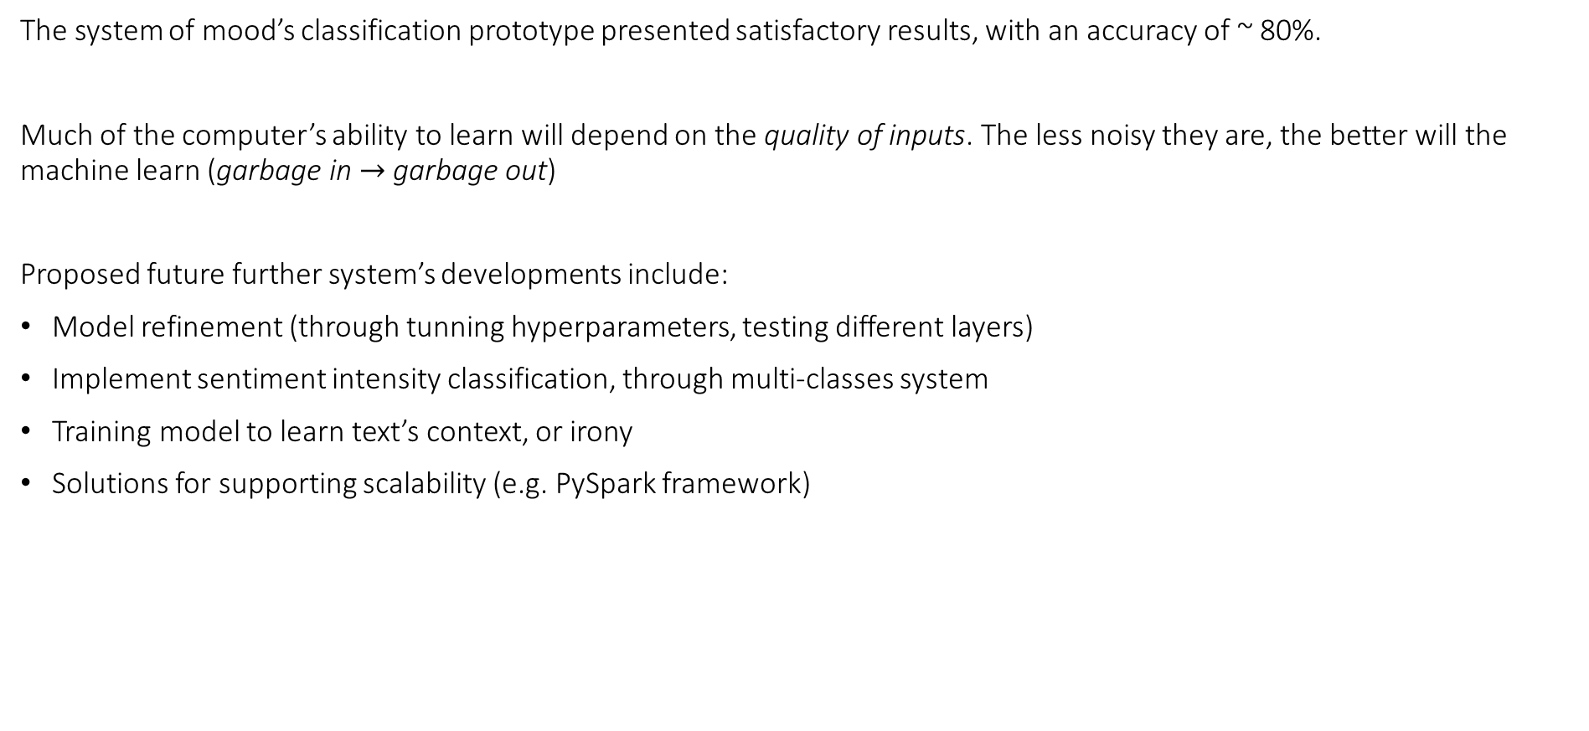
Final Comments and Future Developments
The system of mood’s classification prototype presented satisfactory results, with an accuracy of ~ 80%.
Much of the computer’s ability to learn will depend on the quality of inputs. The less noisy they are, the better will the machine learn (garbage in $→$garbage out)
Proposed future further system’s developments include:
Model refinement (through tunning hyperparameters, testing different layers)
Implement sentiment intensity classification, through multi-classes system
Training model to learn text’s context, or irony
Solutions for supporting scalability (e.g. PySpark framework)

Slide 18

Thank you!
reach me: https://github.com/ricardopss/ibmcapstone

